Slide 1
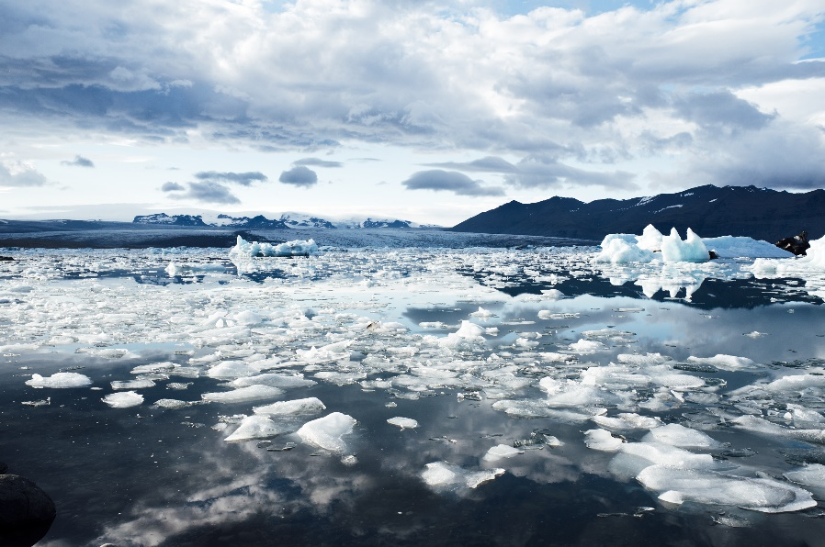
ADAC Quarterly Review
14 May 2020
Oil Spill Modeling for Improved Response to Arctic Maritime Spills
Nancy E. Kinner and Megan Verfaillie
Coastal Response Research Center
Center for Spills and Environmental Hazards
University of New Hampshire

Slide 2
Oil Spill Modeling for Improved Response to Arctic Maritime Spills
ADAC Program Year 6 Annual Meeting 14 May 2020
Project Principal Investigators: Nancy E. Kinner
Lead Institution: University of New Hampshire Coastal Response Research Center (CRRC), Center for Spills in the Environment (CSE)
Project Champion: Kristen Trego (HQ USCG 5RI)
Project Support:
  Sarah Allan (NOAA OR&R ARD)
  MST1 Gary Barnum (PacArea MST1)
  Catherine Berg (NOAA OR&R ERD SSC)
  TBD (Alaska DEC)
  Mark Everett (USCG D17)
  Amy MacFadyen (NOAA OR&R ERD)
  Dr. Phillip McGillivary (USCG PacArea)
  LT Omar Borges (HQ USCG 5RI)
Project Advocates: NOAA ORR and USCG PACAREA and D17

Slide 3
Oil Spill Modeling for Improved Response to Arctic Maritime Spills
ADAC Program Year 6 Annual Meeting 14 May 2020
Project provides a structured approach to gather expert advice to develop models that address USCG Federal On Scene Coordinator (FOSC) core needs during an Arctic spill response.
Overall objective is to identify the:
  Specific needs to be addressed to obtain models that will be functional and effective in the response time scale to advance FOSC decision making during an incident as well as improve the experience gained from exercises and drills
  Current state-of-the-art Arctic maritime oil spill response models
  Potential integration of these models and components from recent research efforts
  Gaps in current models that need to be addressed by future research
Project outcome: Knowledge product/comprehensive report that will clearly delineate characteristics of Arctic oil spill response that make models appropriate required for daily response planning and decision-making

Slide 4
Oil Spill Modeling for Improved Response to Arctic Maritime Spills
ADAC Program Year 6 Annual Meeting 14 May 2020
Project provides a structured approach to gather expert advice to develop models that address USCG Federal On Scene Coordinator (FOSC) core needs during an Arctic spill response.
Overall objective is to identify the:
  Specific needs to be addressed to obtain models that will be functional and effective in the response time scale to advance FOSC decision making during an incident as well as improve the experience gained from exercises and drills
  Current state-of-the-art Arctic maritime oil spill response models
  Potential integration of these models and components from recent research efforts (integration of ice models with oil spill models)
  Gaps in current models that need to be addressed by future research
Project outcome: Knowledge product/comprehensive report that will clearly delineate characteristics of Arctic oil spill response that make models appropriate required for daily response planning and decision-making

Slide 5
Oil Spill Modeling for Improved Response to Arctic Maritime Spills
ADAC Program Year 6 Annual Meeting 14 May 2020
Relation to the Homeland Security Challenge:
Improve understanding of the needs of Arctic oil spill model users (USCG FOSC) and provide a framework for coordinating further modeling efforts. In addition, will provide insight into utility of current state-of-the-art models and areas for further development of components/sub-models.
Methods = 6 Phases:
Phase 1: Formation of Project Core Advisory Team.
Phase 2: Meeting of the Core Team and Key Agency Stakeholders to Determine the Needs of/Questions Addressed by Response Models to Facilitate FOSC Decision Making During Arctic Oil Spill Response.
Phase 3: A Three-Day Workshop on Arctic Maritime Spill Response Modeling.
Phase 4: Working Groups on Specific Response Model Components/Criteria (Draft of Knowledge Product Sections).
Phase 5: Two-Day Workshop to Review Working Group Drafts and Integrate Feedback into Knowledge Product.
Phase 6: Completion of Knowledge Product.

Slide 6
Oil Spill Modeling for Improved Response to Arctic Maritime Spills
ADAC Program Year 6 Annual Meeting 14 May 2020
Progress in Meeting Objectives:
Phase 1: Formation of Project Core Advisory Team → COMPLETE (April 15, 2019)
Phase 2: Meeting of the Core Team and Key Agency Stakeholders to Determine the Needs of/Questions Addressed by Response Models to Facilitate FOSC Decision Making During Arctic Oil Spill Response →
  Meeting of the Core Team → COMPLETE (May 23, 2019)
  Determination of Needs and Questions → COMPLETE (July 12, 2019)
Phase 3: A Three-Day Workshop on Arctic Maritime Spill Response Modeling →
  COMPLETE (December 3-5, 2019)
Phase 4: Working Groups on Specific Response Model Components/Criteria (Draft of Knowledge Product Sections) → IN PROGRESS

Slide 7
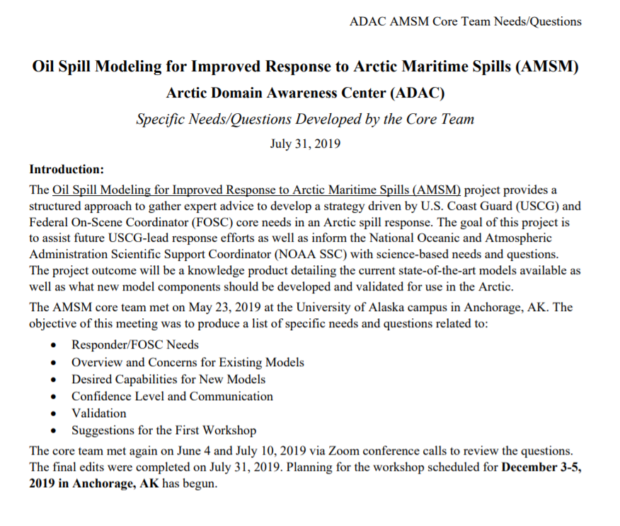
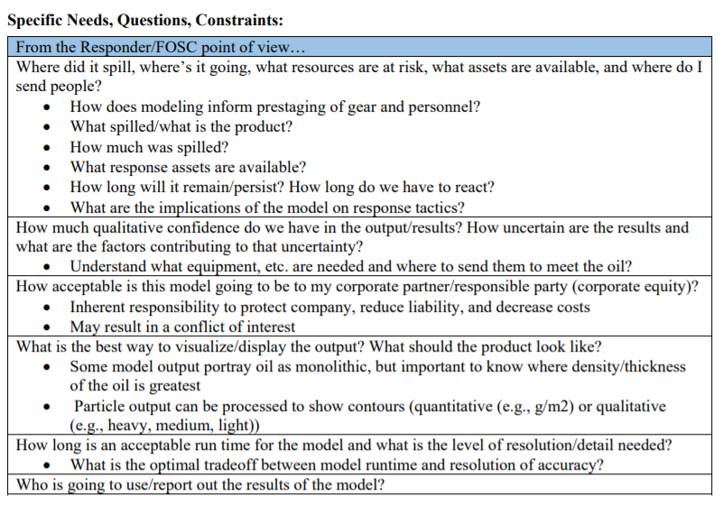
Core Team Needs and Questions (Phase 2)
ADAC Program Year 6 Annual Meeting 14 May 2020

Slide 8
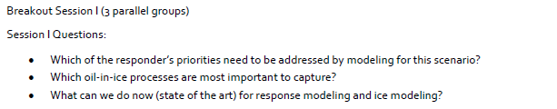

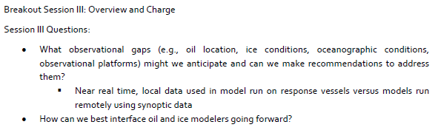
ADAC Program Year 6 Annual Meeting 14 May 2020
Workshop: Oil Spill Modeling for Improved Response to Arctic Maritime Spills
(Phase 3)
49 Participants from the U.S. and international
Ice modelers and oil spill modelers presented on the state of the art models available for the Arctic
Three different scenarios were discussed in breakout groups:
  Well blowout under ice
  Pipeline spill under landfast ice
  Large vessel spill of combinations of oil in the shoulder season (during the fall as ice is developing)

Slide 9
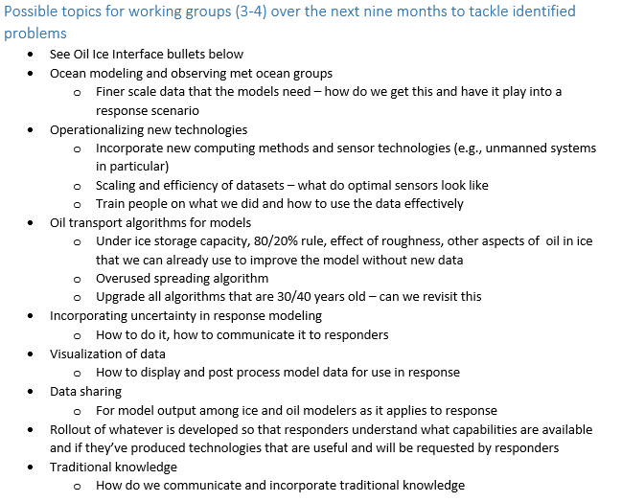
ADAC Program Year 6 Annual Meeting 14 May 2020
Workshop: Oil Spill Modeling for Improved Response to Arctic Maritime Spills
(Phase 3)
Final plenary workshop session discussed four possible working group topics:
  Oil and Ice Interactions (meter scale)
  Oil and Ice Interactions (approximately kilometer ⁺ scale)
  New and Existing Technologies for Observing Ice and Informing Models
  Visualization/Uncertainty

Slide 10
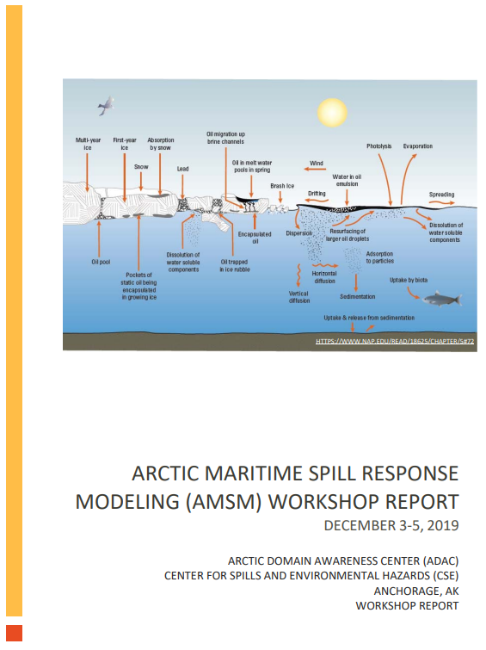
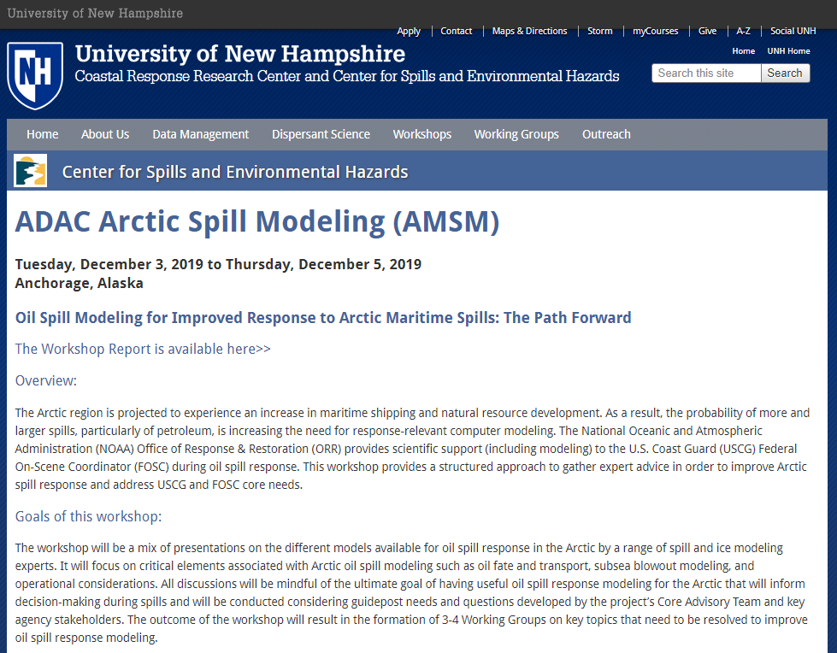
ADAC Program Year 6 Annual Meeting 14 May 2020
AMSM Phase 3 Workshop Report
WWW.CRRC.UNH.EDU

Slide 11
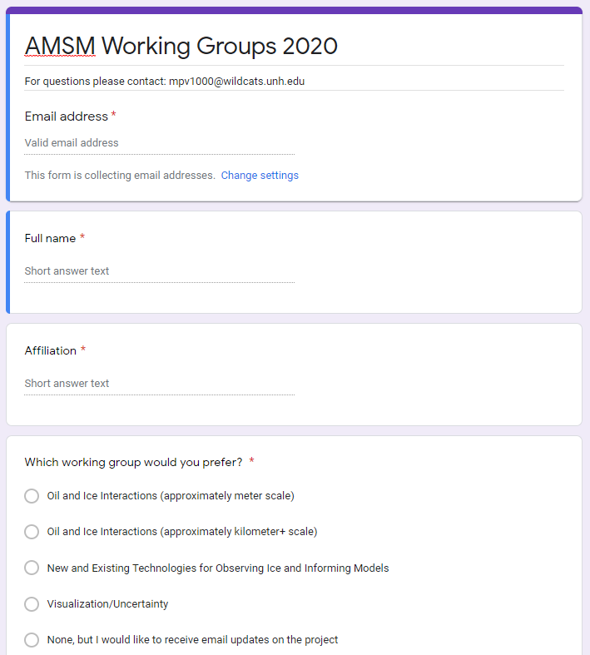
AMSM Working Group Topics (Phase 4)
ADAC Program Year 6 Annual Meeting 14 May 2020
Invitations went to all workshop participants, those invited who could not attend, and others suggested by workshop attendees and Core Team
Meetings began last month
  Each group will meet online every 3 weeks for one hour through mid-October
  Approximately 11 meetings per group
Each working group has a NOAA OR&R modeling representative
Working Groups
  Oil and Ice Interactions (meter scale)
  Oil and Ice Interactions (approximately kilometer ⁺ scale)
  New and Existing Technologies for Observing Ice and Informing Models
  Visualization/Uncertainty

Slide 12
AMSM Working Group Topics: Oil and Ice Interactions (meter scale)
ADAC Program Year 6 Annual Meeting 14 May 2020
Objectives: Determine outputs from sub ice models including what they are and how could they be used to better understand sub models and used in oil spill models to define when oil is going to show up on the ice surface vs. encapsulation vs. enter water under ice
  Who does this kind of sub modeling and what are their sub models? (e.g., sub ice and ice forecasting models, data sets)
  How can oil be included in the existing ice sub models, how do we use output from existing ice sub models to predict the behavior of the ice.
  Discuss how models may mesh with oil spill modelers (e.g., inform high resolution coupled simulations that can feed into larger scale models)
  List dynamic feedback from oil to sub ice models: how does oil affect what ice is doing?
  How do different types/characteristics of ice affect oil behavior?
  How do we recognize/incorporate the value in including traditional knowledge with specialty in small scale ice interactions
    When responders in the field are walking out on the ice its important to be able to identify ice integrity, what might the end result of this be for response modeling? How to bridge this gap. What are the key timescales for the information and processes (near-term vs long-term)?

Slide 13
AMSM Working Group Topics: Oil and Ice Interactions (km+ scale)
ADAC Program Year 6 Annual Meeting 14 May 2020
Objectives: What is the current state of the art ice modeling, revisit oil and ice modified fate and transport algorithms for what improvements can be made?
  Review widely adopted algorithms include: 80/20% rule, degradation, overused spreading algorithm
  Propose algorithms for: Under ice storage capacity, effect of roughness, other aspects of oil in ice that we can already use to improve the model without new data (e.g., using ice velocity from coupled ice ocean model is better than previous rules of thumb, temporal component) oil thickness between ice floes, pumping of oil over and under ice floes
    How does the type of oil affect the algorithms used (e.g., higher pour point for crude oils, thermal effects from blowouts in shallow water that cause melting ice)?
  Are there existing parameters from existing ice-ocean models that are not being used in oil models and could be?
  What is the scale of information that is useful for USCG decision making? How well tested are the algorithms and how do they inform what’s happening? How much information is available in a timely enough manner to be useful? How do the algorithms inform the response options?
  What are the processes that need to be included? What is the value of those parameters?

Slide 14
AMSM Working Group Topics: New and Existing Technologies for Observing Ice and Informing Models
ADAC Program Year 6 Annual Meeting 14 May 2020
Objectives: What new and existing ice and environmental monitoring technologies exist and could be operationalized as inputs to models
  Include Alaska IOOS to determine what data is already being collected (e.g., HF Radar data) that might be useful
  What new technologies might be available (e.g., induced polarization, satellite remote sensing, LRAUV – US and Canadian)?
  How long does it take to deploy certain sensors (e.g., buoys)
  Summarizing information on what technologies/sensors are available, how accessible are they, network between resources within ice modeling and oil spill modeling (e.g., suitable formats to ensure compatibility)
  How would we take what we learn and move it into oil and ice interactions at meter and km+ scale working groups? (Will be done during Phase 4 working group period)

Slide 15
AMSM Working Group Topics: Visualization/Uncertainty
ADAC Program Year 6 Annual Meeting 14 May 2020
Objectives: How uncertainty is shown and the extent to which it is demonstrated in existing oil and ice forecasts?
  What would responders want to know that they aren’t getting now? Especially specific to oil in ice/Arctic.
    Circular error of probability, thickness estimates?
    Which aspects of current model outputs are preferred/do you like?
  How will model outputs be presented into visualization systems used by NOAA (e.g., ERMA) or USCG (e.g., CG1View, HSIN, AIS)?
  Are standard trajectory products an effective communication strategy (if not, what needs to be done (i.e., response community, public))?
  How should this product evolve to suit modern needs in the Arctic (e.g., show where the ice is)?
  How to visualize/convey uncertainty? How are these things currently conveyed by oil and ice models?
  How can model outputs and field data be compared (e.g. not just visually)?
  Do the models accurately predict what actually happens and how can models be adjusted in real time to make predictions better?

Slide 16
ADAC Program Year 6 Annual Meeting 14 May 2020
Oil Spill Modeling for Improved Response to Arctic Maritime Spills
Phase 1
Phase 2
Phase 3
3 Day Workshop on Arctic Maritime Spill Response Modeling
Phase 4
Phase 5
Phase 6
ADAC Program Year 7
Define Needs/Questions Addressed by Response Models
Formation of Core Team
Develop Working Groups
2 Day Workshop to Draft Knowledge Product
ADAC Program Year 5
ADAC Program Year 5
ADAC Program Year 6
ADAC Program Year 6
ADAC Program Year 7
Completion of Knowledge Product
COMPLETE
COMPLETE
COMPLETE
ONGOING
FUTURE
FUTURE

Slide 17
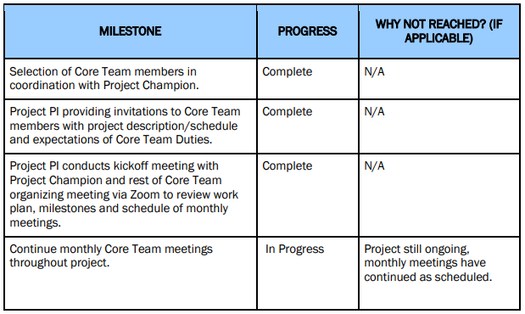
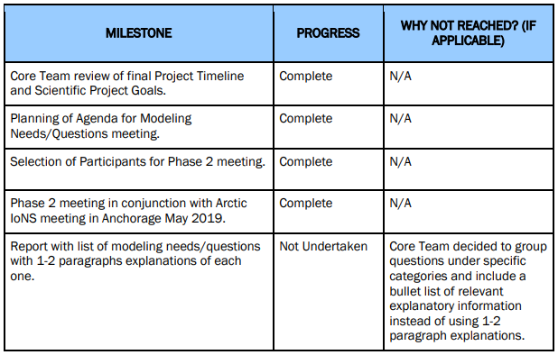
PHASE 1 MILESTONES
ADAC Program Year 6 Annual Meeting 14 May 2020
PHASE 2 MILESTONES

Slide 18
PHASE 3 MILESTONES
ADAC Program Year 6 Annual Meeting 14 May 2020
MILESTONE | PROGRESS | WHY NOT REACHED? (IF APPLICABLE)
Project PI leads selection of workshop Organizing Committee (OC) in coordination with Core Team. | Complete | N/A
Project PI convenes OC and provides charge to its members. | Complete | N/A
Project PI conducts monthly meetings of OC to solidify workshop objectives, dates/location, & agenda, including speakers and breakout groups, and participants. | Complete | N/A
Project PI leads planning of logistical support for workshop (e.g., venue selection, travel arrangements, audio/video supplies, room arrangements, lodging contracts, participant packet materials) in coordination with ADAC staff. | Complete | N/A
Project PI leads execution of associated workshop in December 2019. | Complete | N/A
Project PI completes report from workshop including charge to follow-on Working Groups (reviewed and approved by Core Team and OC). | Complete | N/A

Slide 19
PHASE 4 MILESTONES (IN PROGRESS)
ADAC Program Year 6 Annual Meeting 14 May 2020
MILESTONE | PROGRESS | WHY NOT REACHED? (IF APPLICABLE)
Project PI leads formation of Working Groups following the Phase 3 workshop. | Complete | N/A
Working Group co-lead selection (one of the co-leads from each group will be from a governmental agency). | Complete | N/A
Project PI facilitates monthly meetings of the 3-4 Working Groups. | In Progress | Meetings ongoing now through mid-October
Project PI facilitates monthly meetings of Core Team and Working Group co-leads for cross coordination. | In Progress | Meetings ongoing monthly
Project PI conducts scheduled cross-team Working Group meetings. | Not Yet Undertaken | Meetings will be scheduled as Working Groups start producing information
Project PI coordinates drafting of Working Group reports with onward edits provided by co-leads, reviewed and approved by Working Group members. | Not Yet Undertaken | Will occur during/following Working Group meetings.

Slide 20
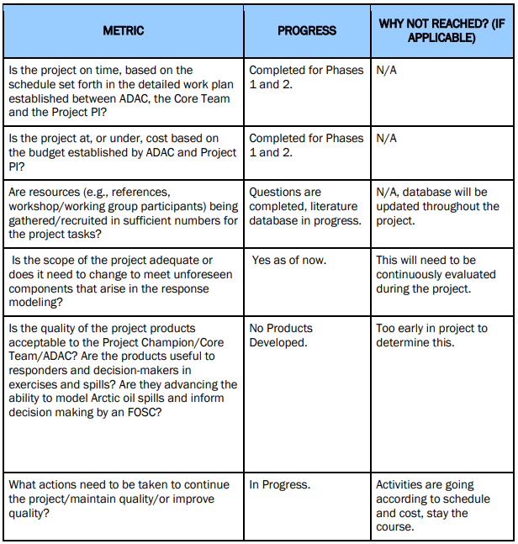
PROGRESS AGAINST EACH METRIC
ADAC Program Year 6 Annual Meeting 14 May 2020
Workshop 1 report completed and reviewed and accepted by Core Team
Will be continuously evaluated by Core Team and Project Champion

Slide 21
Oil Spill Modeling for Improved Response to Arctic Maritime Spills
ADAC Program Year 6 Annual Meeting 14 May 2020
Student Participation:
ADAC Fellows: Megan Verfaillie and Jessica Manning
  Participate in Core Team and Workshop Organizing Committee phone calls
  Draft and organize documents for Core Team and Workshop Organizing Committee
  Conduct literature review of relevant papers and research
  Completed Arctic Summer Internship Program (ASIP) for Summer 2019
  Megan met with NOAA OR&R modelers in Seattle, WA during Summer 2019
  Jessica completed summer internship on submerged oil research during Summer 2019
  Jessica and Megan attended the Arctic Maritime Spill Response Modeling (AMSM 2019) workshop, the Response Oil Assay workshop in Seattle, WA, and visited the Pacific Northwest National Laboratory (PNNL) MSL Lab in Sequim, WA
  Megan attended the Coordinating Recent Advances in Estimating and Measuring Oil Slick Thickness (CAMPRI 2019) workshop and NRPT Scoping Workshop in Mobile, AL during February 2020
  Jessica will participate in ADAC ASIP Summer 2020 Program (REMOTE)
  Megan will be conducting research at UNH

Slide 22
Oil Spill Modeling for Improved Response to Arctic Maritime Spills
ADAC Program Year 6 Annual Meeting 14 May 2020
  Outcomes/Output and TRLs:
  Project performs a Needs Assessment, which is a different Technology Phase outside TRLs
  Spans multiple possible levels of TRLS and Technology Phases (e.g., 3, 8 or 9)

Slide 23
Oil Spill Modeling for Improved Response to Arctic Maritime Spills : Questions?
ADAC Program Year 6 Annual Meeting 14 May 2020
Feedback…
What are we missing?
What can we improve?
Who should we connect with to improve odds of research success?
Contact information:
nancy.kinner@unh.edu
603-479-3777
www.crrc.unh.edu

